Slide 1
Slang Word Adoption in the Information Age
Rodrigo Ivan Rodriguez
DSC 500 Summer Project

Slide 2
Overview
Introduction
Analysis
Findings / Next Steps
Summary

Slide 3
INTRODUCTION
In this project I aimed to confirm my hypothesis that slang words are adopted at a much faster rate in the information age, than prior to the information age.
The goal was to use Google Trends data to gain insight into usage, adoption, influence, and dispersion of slang words across the United States.

Slide 4
PRIMARY Analysis
Google Trends Time Series Data

Slide 5
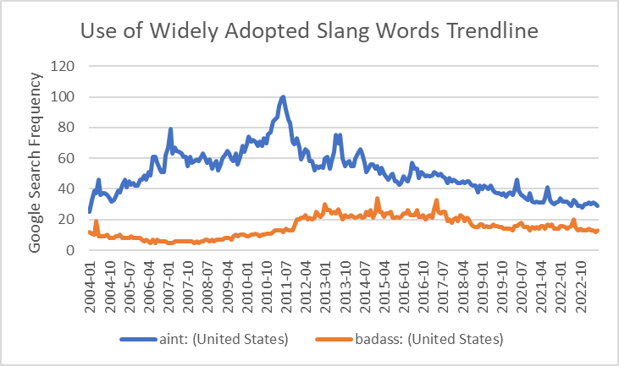
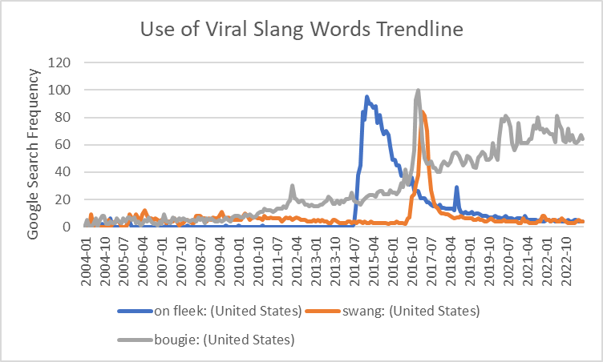
Widely Adopted Slang vs. Viral Slang
WIDELY ADOPTED WORDS
VIRAL SLANG WORDS
The analysis involved using Google Trends data to visualize slang word usage over time.
By utilizing time series data, we can easily observe the rapid growth seen in newer slang words.
New slang words can experience virality similar to other digital content in the information age. The presence of virality demonstrates that adoption occurs at an accelerated rate.
However, most viral slang words rarely retain their high adoption.

Slide 6
Slang word influence on adoption
VIRAL SALNG WORDS
RELATED GOOGLE SEARCH QUIERIES
When exploring factors that may accelerate the use of slang words, I discovered that influential figures, such as rappers or influencers, can boost the adoption of slang words.
If we look at the related search queries to the word “swang” in summer 2017 (when the word experienced virality) we can see that 4 out of 5 top searches related to a popular rap song that emphasizes this word.
The popular rap song “Swang” by Rea Sremmurd peaked at 26 in the Billboard’s Hod 100 list for 2017, thus leading to the slang word’s accelerated mass adoption.
swang lyrics
rea sremmurd swang
rea sremmurd
swang on
swang download

Slide 7
Slang Word dispersion
3 KEY CALL OUTS
SLANG WORDS CAN ORIGINATE ANYWHERE
SLANG WORDS CAN BE ISOLATED TO CERTAIN REGIONS
SLANG IS PREVELANT IN THE SOUTH
Slang word adoption data shows that slang words can originate anywhere.
Slang words often originate within niche sub-cultures as a means to communicate specifically with members within the sub-culture.
Slang words can still be isolated to certain regions, despite the word existing for years during the information age.
Words are centralized to their region of origination and may not always expand beyond the region of origination.
Regions that continuously appeared with more frequent use across various terms were southern regions.
There is not enough data in google searches to try to understand why this is.

Slide 8
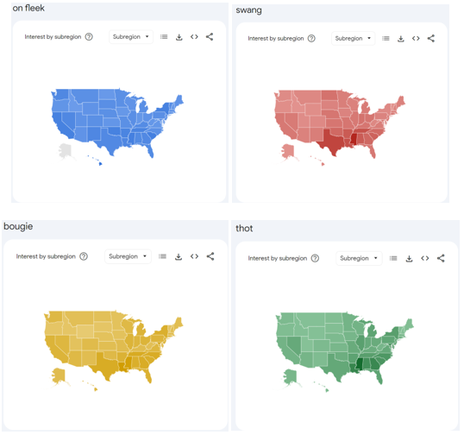
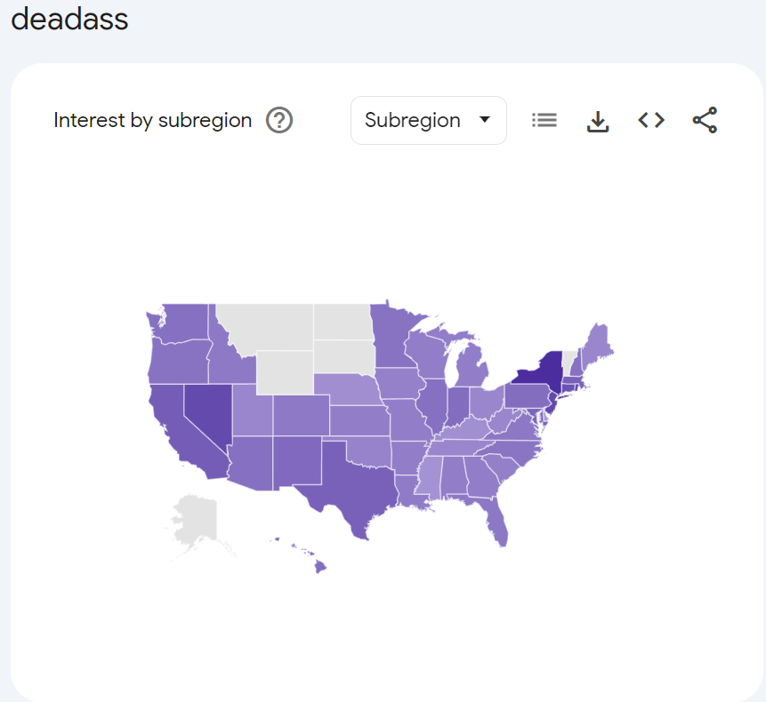
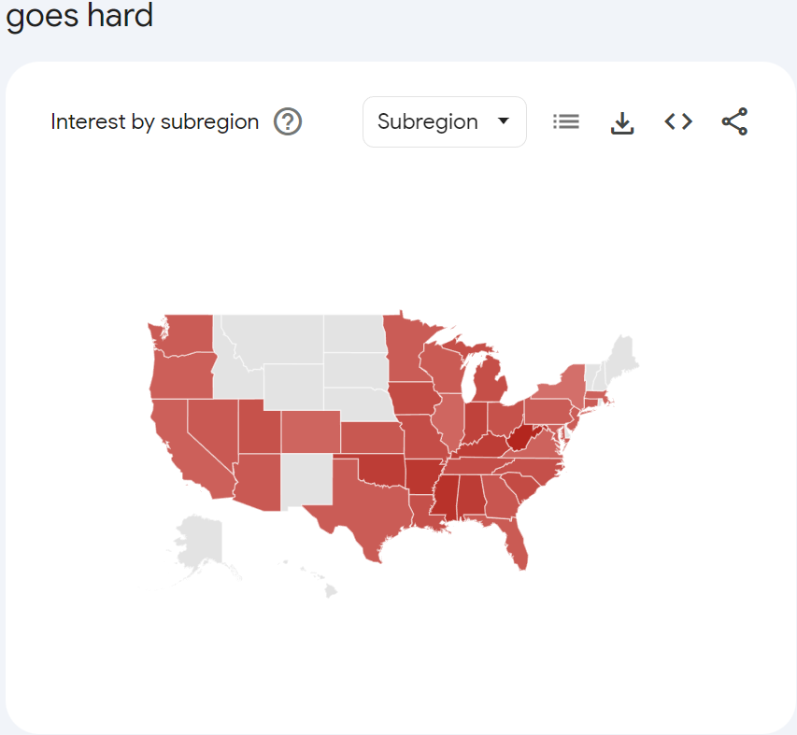
Slang word dispersion
VISUAL
Darker shading indicates increased usage in Southern Regions.
Gray shading indicates lack of usage, and thus slang word isolation.

Slide 9
Findings
And Next Steps

Slide 10
Slang words are created and adopted at a high rate in the information age
Data from 2004 to 2001.
After reviewing the results of the analysis, we can determine that slang words are in fact adopted at a high rate, and experience virality. We can see that words can be popularized by influential individuals and spread across the nation
Prior to the information age slang words could not experience the same overnight growth in adoption. However, although I am confident this is the case, we are not able to prove absolutely that these occurrences are exclusive to or happen at a faster rate in the information era than in previous times.
Since Google Trends data only goes as far back as 2004, we cannot utilize this dataset to observe slang word usage and adoption prior to 2004.

Slide 11
Next Steps
Additional Data
Obtain data prior to 2004 from another data source. A potential data source could be frequency of slang terms in newspaper articles or books written prior to the information age
Wider Range of Slang Words
We need to examine a wider range of slang terms to determine definitively which region has higher propensity to adopt slang words and to determine a cause more accurately for a slang term’s virality
Additional Variables
Additional variables will allow us cross-reference correlations to try to identify if any other variables may correlate with increased adoption of slang words. This will help more clearly pin-point what may be causing increased adoption.
Additional Resources
This project can have various positive impacts. With more resources such as, time and personnel, we could expend on the findings from this project for greater overall impact.

Slide 12
Summary
Conclusion

Slide 13
Challenges / concerns / Opportunities
To help improve natural language processing (NLP) and machine learning techniques to analyze and visualize trends in slang word usage over time.
CHALLENGES
Lack of data prior to 2004.
Lack of additional data points.
CONCERNS
Ethical concerns need to be understood and evaluated prior to distribution of project results.
(Improper interpretation of results. See project paper for details).
OPPORTUNITY
Understanding of language trends, communication styles, and cultural changes within different regions can have positive business applications.
To understand how language evolves and adapts in the digital age and provide insights into cultural shifts and communication patterns.
OPPORTUNITY
OPPORTUNITY

Slide 14
conclusion
In conclusion, this project determined that slang words are in fact adopted at a high rate during the information age. There is room to expand don this research and opportunity for this research to have multiple business and educational applications. With additional time and resources, we can continue this research and understand how language and communication changes over time in the current age.

Slide 15
THANK YOU
Rodrigo Ivan Rodriguez
DSC 500 Summer Project

